Slide 1
Topic Modeling on News Articles
Face Emotion Recognisation
Manoj Kumar

Slide 2
Topics for discussion
Exploring the data
Data Description
Testing the model in Real-time using OpenCV and WebCam
conclusion
Creating our Deep Learning model
Model architecture
Model training

Slide 3
Exploring the data
This first section contains the utility functions to load the dataset to be used for our model training.
The dataset used for this project is the one published in the "Challenges in Representation Learning: Facial Expression Recognition Challenge" by Kaggle.

Slide 4
Data Description:
The data consists of 48x48 pixel grayscale images of faces. The faces have been automatically registered so that the face is more or less centered and occupies about the same amount of space in each image. The task is to categorize each face based on the emotion shown in the facial expression in to one of seven categories (0=Angry, 1=Disgust, 2=Fear, 3=Happy, 4=Sad, 5=Surprise, 6=Neutral).
The csv file contains two main columns, "emotion" and "pixels". The "emotion" column contains a numeric code ranging from 0 to 6, inclusive, for the emotion that is present in the image. The "pixels" column contains a string surrounded in quotes for each image. The contents of this string a space-separated pixel values in row major order. test.csv contains only the "pixels" column and your task is to predict the emotion column.
This dataset was prepared by Pierre-Luc Carrier and Aaron Courville, as part of an ongoing research project. They have graciously provided the workshop organizers with a preliminary version of their dataset to use for this contest.

Slide 5
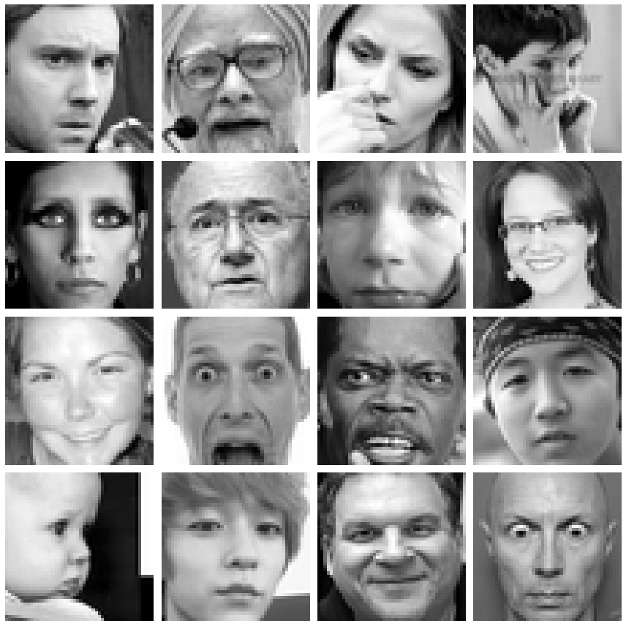

Slide 6
Creating our Deep Learning model

Slide 7
Model Architecture

Slide 8
Model Architecture
After some research in the state of the art for Facial Expression Recognition, found that a simple convolutional architecture based on LeNet-5 would achieve nice results.
Anyway, more recent proposals have achieved
more accurate results, and even if Tensorflow
already includes prebuilt models (such as
MobileNet, which is one of the best model
architectures for portable devices), I came up
with my own implementation based on a neetwrk
architecture which is supposed to be a deep-
lightweight accurate model for the FER problem: "
[Extended deep neural network for facial emotion
recognition (EDNN)]

Slide 9
Model Architecture
they assure through some tests that their EDNN gives better results in classification tasks for Facial Expression Recognition, and by the architecture metrics this network turns out to be a more lightweight model compared with others.
In any case, I proceeded to use Tensorflow 2.0 to build my own EDNN implementation with the Keras module.
The implementation will come from two functions:
One to build the Residual Block
The second one to build the rest of the model

Slide 10
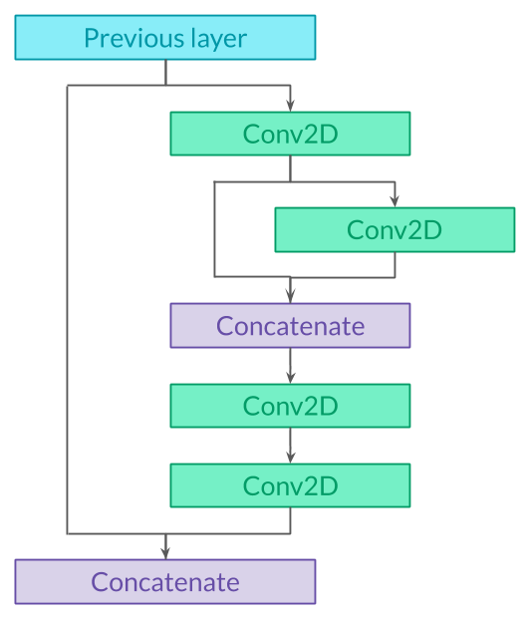
Model Architecture
The residual block architecture is as follows:

Slide 11
Model: "model"
Layer (type) Output Shape Param # Connected to
input_1 (InputLayer) [(None, 48, 48, 1)] 0
conv2d (Conv2D) (None, 22, 22, 32) 832 input_1[0][0] __________________________________________________________________________________________________
max_pooling2d (MaxPooling2D) (None, 11, 11, 32) 0 conv2d[0][0] __________________________________________________________________________________________________
conv2d_1 (Conv2D) (None, 9, 9, 64) 18496 max_pooling2d[0][0] __________________________________________________________________________________________________
conv2d_2 (Conv2D) (None, 9, 9, 64) 4160 conv2d_1[0][0] __________________________________________________________________________________________________
conv2d_3 (Conv2D) (None, 9, 9, 64) 36928 conv2d_2[0][0] __________________________________________________________________________________________________
concatenate (Concatenate) (None, 9, 9, 128) 0 conv2d_2[0][0] conv2d_3[0][0] __________________________________________________________________________________________________
conv2d_4 (Conv2D) (None, 9, 9, 128) 147584 concatenate[0][0] __________________________________________________________________________________________________
conv2d_5 (Conv2D) (None, 9, 9, 256) 33024 conv2d_4[0][0] __________________________________________________________________________________________________
concatenate_1 (Concatenate) (None, 9, 9, 320) 0 conv2d_5[0][0] conv2d_1[0][0] __________________________________________________________________________________________________
conv2d_6 (Conv2D) (None, 9, 9, 128) 368768 concatenate_1[0][0] __________________________________________________________________________________________________
max_pooling2d_1 (MaxPooling2D) (None, 4, 4, 128) 0 conv2d_6[0][0] __________________________________________________________________________________________________
conv2d_7 (Conv2D) (None, 2, 2, 128) 147584 max_pooling2d_1[0][0] __________________________________________________________________________________________________
conv2d_8 (Conv2D) (None, 2, 2, 64) 8256 conv2d_7[0][0] __________________________________________________________________________________________________
conv2d_9 (Conv2D) (None, 2, 2, 64) 36928 conv2d_8[0][0] __________________________________________________________________________________________________
concatenate_2 (Concatenate) (None, 2, 2, 128) 0 conv2d_8[0][0] conv2d_9[0][0] __________________________________________________________________________________________________
conv2d_10 (Conv2D) (None, 2, 2, 128) 147584 concatenate_2[0][0] __________________________________________________________________________________________________
conv2d_11 (Conv2D) (None, 2, 2, 256) 33024 conv2d_10[0][0] __________________________________________________________________________________________________
concatenate_3 (Concatenate) (None, 2, 2, 384) 0 conv2d_11[0][0] conv2d_7[0][0] __________________________________________________________________________________________________
conv2d_12 (Conv2D) (None, 2, 2, 256) 884992 concatenate_3[0][0] __________________________________________________________________________________________________
max_pooling2d_2 (MaxPooling2D) (None, 1, 1, 256) 0 conv2d_12[0][0] __________________________________________________________________________________________________
conv2d_13 (Conv2D) (None, 1, 1, 512) 1180160 max_pooling2d_2[0][0] __________________________________________________________________________________________________
flatten (Flatten) (None, 512) 0 conv2d_13[0][0] __________________________________________________________________________________________________
dense (Dense) (None, 1024) 525312 flatten[0][0] __________________________________________________________________________________________________
dropout (Dropout) (None, 1024) 0 dense[0][0] __________________________________________________________________________________________________
dense_1 (Dense) (None, 512) 524800 dropout[0][0] __________________________________________________________________________________________________
dropout_1 (Dropout) (None, 512) 0 dense_1[0][0] __________________________________________________________________________________________________
dense_2 (Dense) (None, 7) 3591 dropout_1[0][0] ==================================================================================================
Total params: 4,102,023 Trainable params: 4,102,023 Non-trainable params: 0

Slide 12
Model Training

Slide 13
ednn.fit
Train on 28709 samples, validate on 7178 samples 28709/28709 [==============================] - 508s 18ms/sample - loss: 1.8201 - accuracy: 0.2817 - val_loss: 1.6472 - val_accuracy: 0.3576

Slide 14
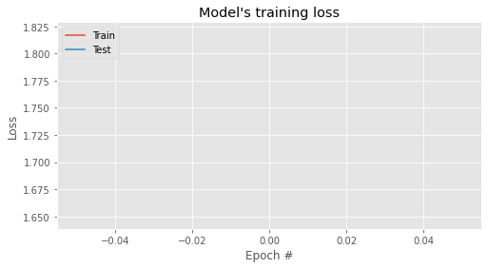
# Plot loss:

Slide 15
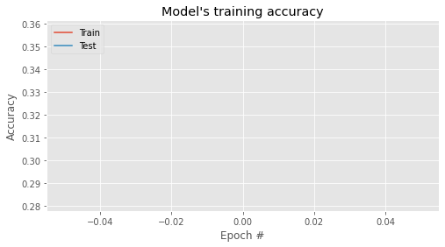
# Plot Accuracy:

Slide 16
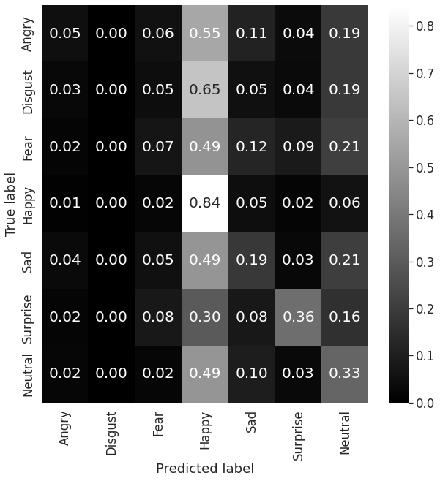
Confusion Matrix

Slide 17
Testing the model in Real-time using OpenCV and WebCam

Slide 18
Import OpenCV.
import cv2
Since we want to detect the objects in real-time, we will be using the webcam feed. Use the below code to initiate the webcam
# Enable we
# '0' is default ID for builtin web cam
# for external web cam ID can be 1 or -1
imcap = cv2.VideoCapture(0)
imcap.set(3, 640) # set width as 640
imcap.set(4, 480) # set height as 480

Slide 19
As mentioned earlier, OpenCV has various pre-trained HAAR classifiers stored as XML files. In this example, I am using haarcascade_frontalface_defaul a classifier for face detection. You can check other pre-trained classifiers in opencv/data/harrcascades/ folder

Slide 20
The next step will be to run the classifier to detect the face in the video feed and the webcam. The basic steps are; first, we capture the frame from the video feed. Next, the captured frame is converted to grayscale. Finally, the grayscale image is passed through the classifier to detect the required object.

Slide 21
Conclusion
⦁ This first section contains the utility functions to load the dataset to be used for our model training.
⦁ The dataset used for this project is the one published in the "Challenges in Representation Learning: Facial Expression Recognition Challenge"
⦁ The csv file contains two main columns, "emotion" and "pixels". The "emotion" column contains a numeric code ranging from 0 to 6, inclusive, for the emotion that is present in the image.
⦁ We created our deep learning model in which we created model architecture in which we created layers and in model training we fit the model
⦁ We tested the model in real time using opencv and python
⦁ After importing all the required libraries we will load the model weights that we saved earlier after training.
⦁ we have imported a haar cascade file that is designed by open cv to detect the frontal face.
⦁ After importing the haar cascade file we will have written a code to detect faces and classify the desired emotions.

